Slide 1

Mobile Style Password System.
By Isneha Varshney
Jaypee University

Slide 2

Introduction
This C++ project simulates a password setup system similar to mobile phones.
Users can select from three password types: PIN, Pattern, or Alphanumeric.
It also includes a 'Forgot Password' feature with secure verification.

Slide 3

Objective
Mimic
- Mimic mobile password setup in C++
Practice
- Practice logic and condition handling
Understand
- Understand password-based authentication flows

Slide 4

Technology Stack
- C++ Programming Language
- Loops, if-else Conditions
- String Handling
- Functions

Slide 5

Features
- Choose from PIN / Pattern / Alphanumeric
- Enter and save your password
- Unlock using entered password
- Forgot password option with verification
- Secure reset system

Slide 6

Project Flow
1. User chooses password type
2. Password is stored
3. User can unlock, forget, or exit
4. If forgot, secret key is required
5. Password can then be reset

Slide 7
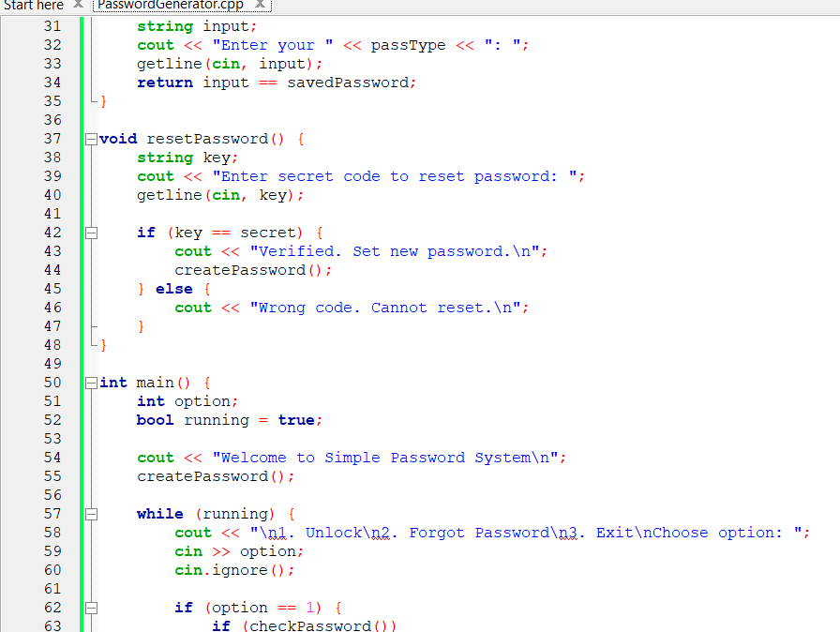
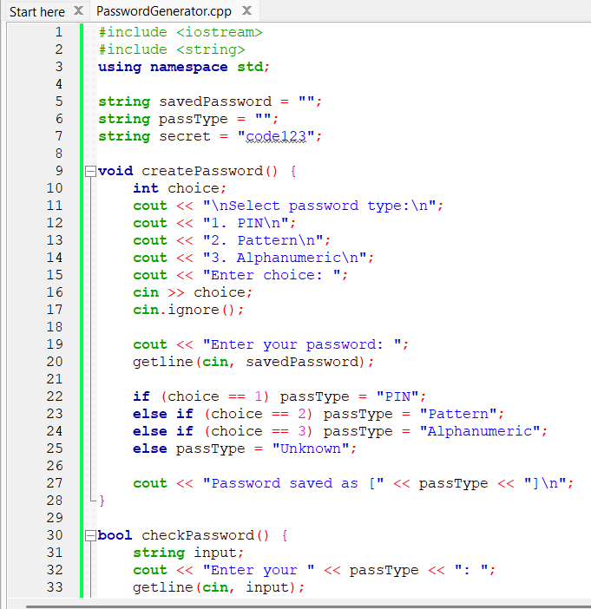
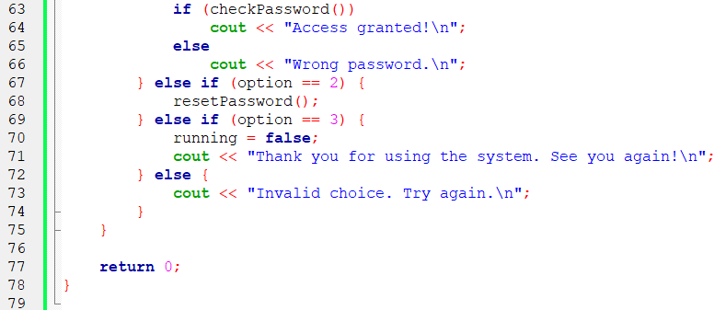
Code Snapshots

Slide 8

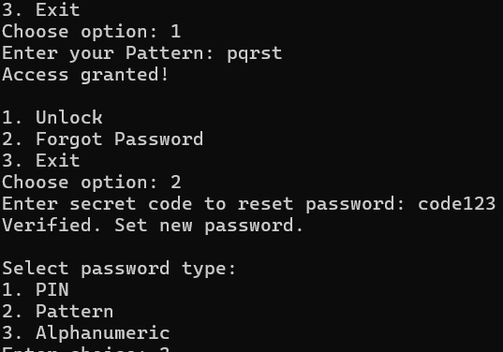
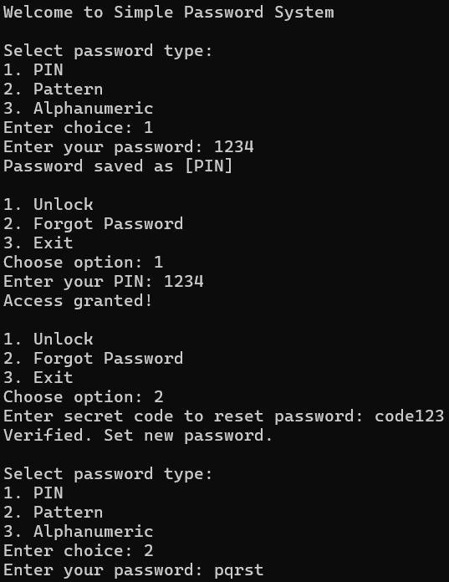
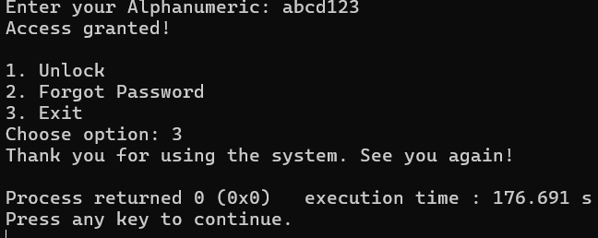
Output Preview

Slide 9
Real-World Application
Used in mobile phone app, Secure system
Authentication based access
Password recovery flows

Slide 10

Learnings
- Improved C++ syntax and logic
- Implemented real-world user interaction
- Understood verification and access control systems.

Slide 11

Conclusion
A simple but powerful project that helped me learn password systems.
I understood how to manage user inputs and apply conditional logic.
Strengthened my foundation in C++ and logical thinking.
Motivated to explore more secure and user-friendly applications in future.

Slide 12


Thank you so much for your time! I really enjoyed working on this project 😊

